Slide 1
Chapter 3:
Consumer Preferences and the Concept of Utility
Saba Bukhari
Department of Economics

Slide 2
Utility Function
Utility Function: measures the level of satisfaction that a consumer receives from any basket of goods and services.
consumer behavior:
The study of how individuals make decisions to allocate their resources (income, time) among various goods and services to maximize their level of utility.
Importance: Helps in understanding demand patterns and market behavior.

Slide 3
Utility Function (one good in utility)
Are the assumptions on preferences meet?
U(y): total utility of muffins
U(y) = y^{.5}
1.75
C
1.5
B
Graph showing TU curve increasing at a decreasing rate.
1.0
A
1
2
3
y, weekly consumption of muffins
Slopes on A and C give marginal utility – each additional unit makes person happy but by less than the previous unit that’s why MU of consumption decreases with increase in consumption of additional unit of any good or service.

Slide 4
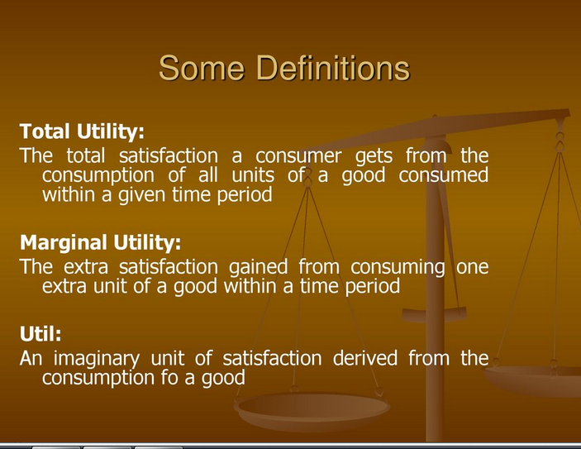
TU
MU

Slide 5
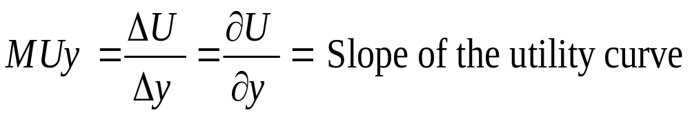
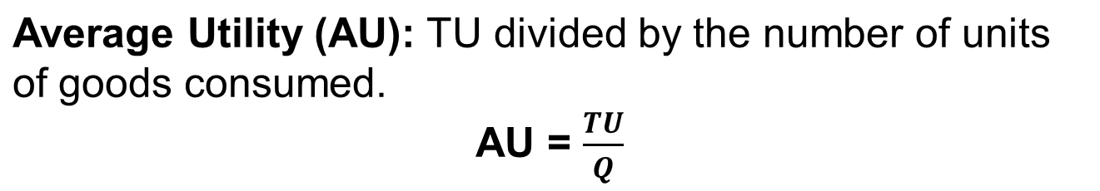
Marginal Utility
Marginal Utility: Rate at which total utility changes as the level of consumption rises by one more unit.
Each new muffin makes you happier, but makes you happier by smaller and smaller amount.

Slide 6
continued
Total Utility (TU): Increases as more units are consumed but at a decreasing rate.
Average Utility (AU): TU divided by quantity.
​Law of Diminishing Marginal Utility: As consumption of any good or services increases, its MU decreases.

Slide 7
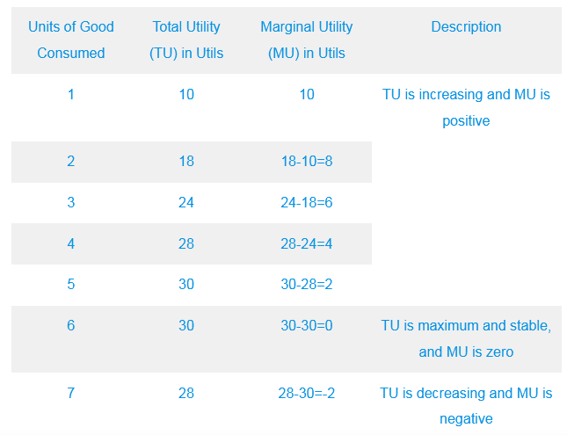
TU, AU and MU Calculations

Slide 8
Indifference Curve (IC)
Clothing
IC shows different combinations of two goods that gives a consumer a same level of satisfactions
IC is negatively sloped and it is convex to origin
Same level of utility for bundle A, B, and C
Slope of indifference curve is called MRS
A
B
C
IC₁ for U=4
food

Slide 9
Properties of IC
Negatively sloped
Convex to origin
IC’s are not thick line
IC donot intersect or cross with each other
A higher IC shows a higher level of satisfaction

Slide 10
Consumer Reaches Equilibrium Using the Marginal Utility Approach and the Indifference Curve Approach.
Consumer Equilibrium
Consumer equilibrium refers to the situation where a consumer maximizes their total utility given their budget constraint.
A consumer can reach equilibrium through two main approaches
The Marginal Utility Approach (Cardinal Utility Theory)
The Indifference Curve Approach (Ordinal Utility Theory)
Cardinal approach: utility is countable or measureable in utils
Ordinal approach: utility is not countable we can only define the order of our preferences

Slide 11
1. Consumer Equilibrium Using the Marginal Utility Approach
Assumptions: There are only two goods. Good X and Y. consumer’s income (M) is fixed and the prices of good X and Y i.e. PX and PY are fixed. There is no change in tastes also.
Statement: The marginal utility per dollar spent on each good must be equal for equilibrium. Or
The law states that in order to get maximum satisfaction, a consumer should spend his limited income on different commodities in such a way that the last rupee spent on each commodity yields him equal marginal utility. MUX/PX = MUY/PY
The consumer compares the marginal utility per dollar spent on different goods. If MU per dollar spent on one good is higher than another, the consumer shifts spending toward that good. E.g. if MUX/PX ˃ MUY/PY Consumer will increase the consumption of good X. This continues until the MU per dollar spent is equal for all goods within the budget.

Slide 12
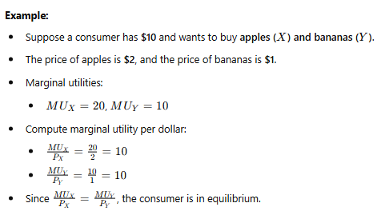
Continued..

Slide 13
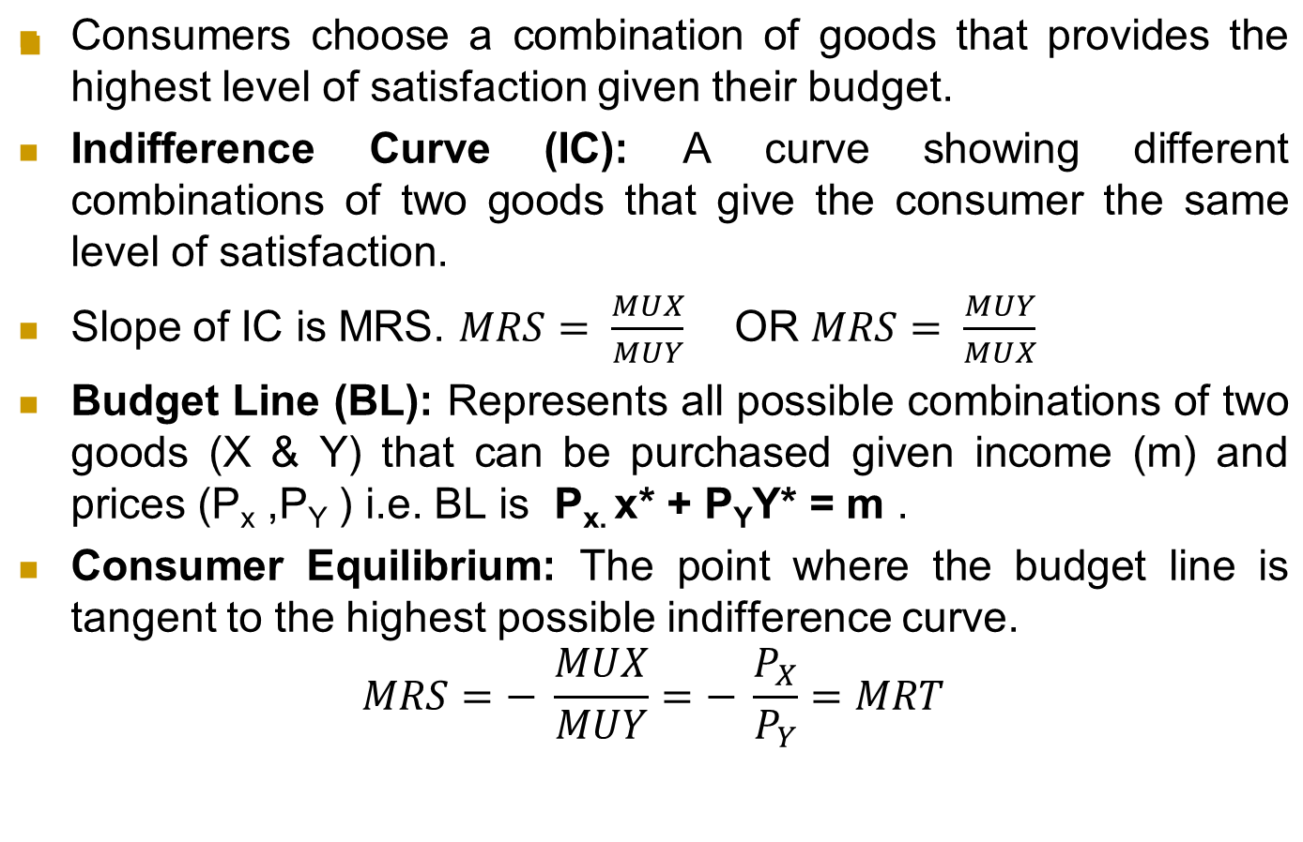
2. Consumer Equilibrium Using The Indifference Curve Approach

Slide 14
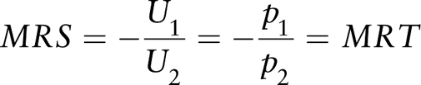
MRS (Marginal Rate of Substitution): The rate at which a consumer is willing to trade one good for another while maintaining the same satisfaction level. MRS is the slope of IC.
Marginal rate of Transformation (MRT) is PX/PY: The price ratio of the two goods and slope of BL.

Slide 15
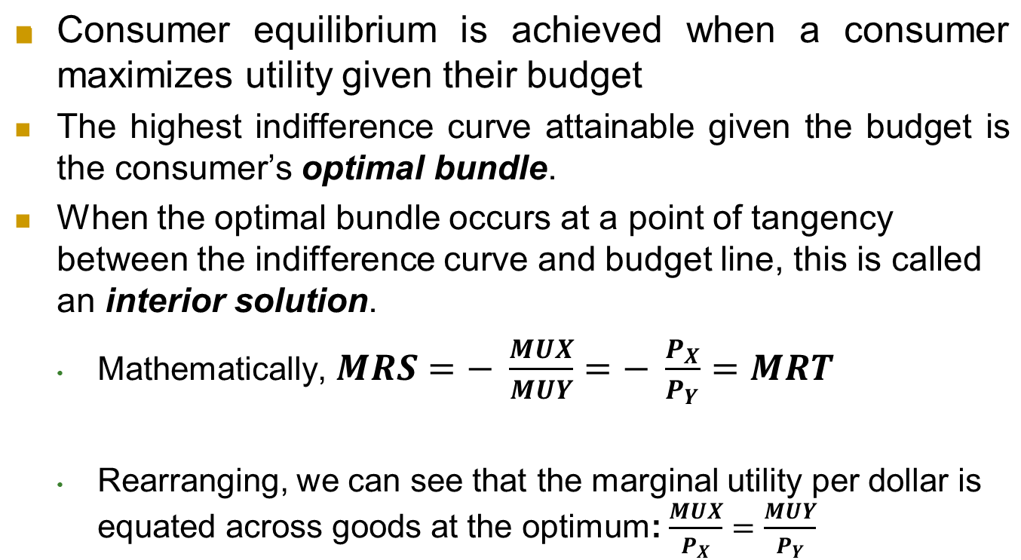
Consumer Equilibrium

Slide 16
Rational Constrained Choice
x
(x*,Y*) is the optimal choice for the consumer.
(x*,Y*) satisfies two conditions for the optimal choice i.e.
(a) the budget is exhausted;
P_{x} x * + P_{Y}Y₂* = m .
(b) The slope of the indifference curve at (x*, Y*) equals the slope of the budget constraint.
x*
e
In both cases, equilibrium is reached when the consumer maximizes satisfaction given their income and the prices of goods.
Y*
Y

